Slide 1
WAYNE COUNTY
OVERDOSE
PREVENTION
Robert Sanders Jr, MPH
Community Behavioral Health Program Coordinator
Wayne County Department of Health, Human, and Veterans Services
Parker Tomkinson, MSc
Program Manager
Treatment Ecosystems
Center for Behavioral Health and Justice
Wayne State University School of Social Work
Local data and drug trends,
overdose prevention, and harm reduction
Plymouth District Library
October 13, 2025

Slide 2
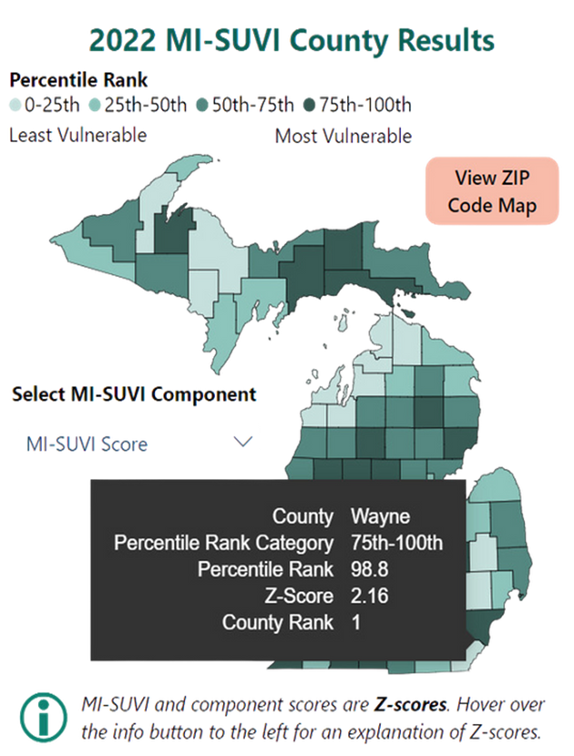
WAYNE COUNTY OVERDOSE IMPACT
Wayne County experiences the most overdose deaths of any county in Michigan
First in “Substance Use Vulnerability” (MI-SUVI)
Fourth in overdose rate
Approximately 936 drug overdose deaths in 2023
Nearly one third of all overdose deaths in Michigan
Source: Michigan Overdose Data to Action (MODA) Dashboard, Michigan Department of Health and Human Services (2024)
https://www.michigan.gov/opioids/category-data

Slide 3
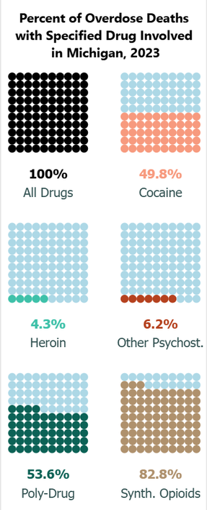
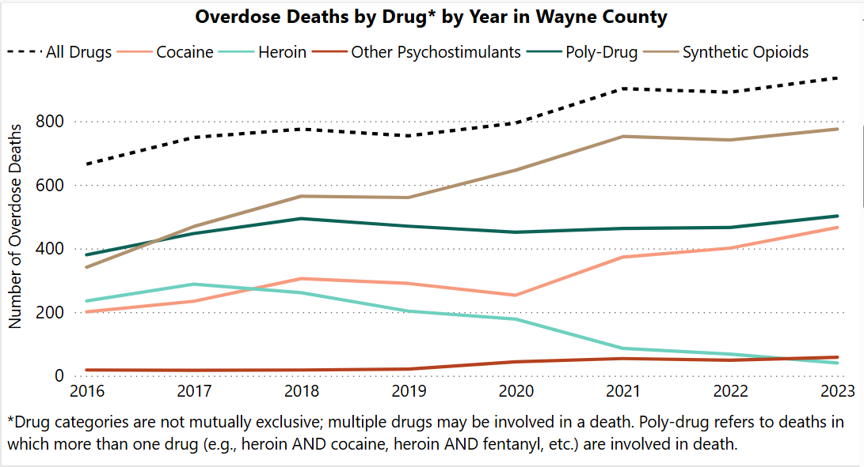
Fentanyl drives 4 out of 5 overdose deaths
More than half of deaths involve more than one drug
Nearly half of deaths involve cocaine
Source: Michigan Overdose Data to Action (MODA) Dashboard, Michigan Department of Health and Human Services (2024)
https://www.michigan.gov/opioids/category-data

Slide 4
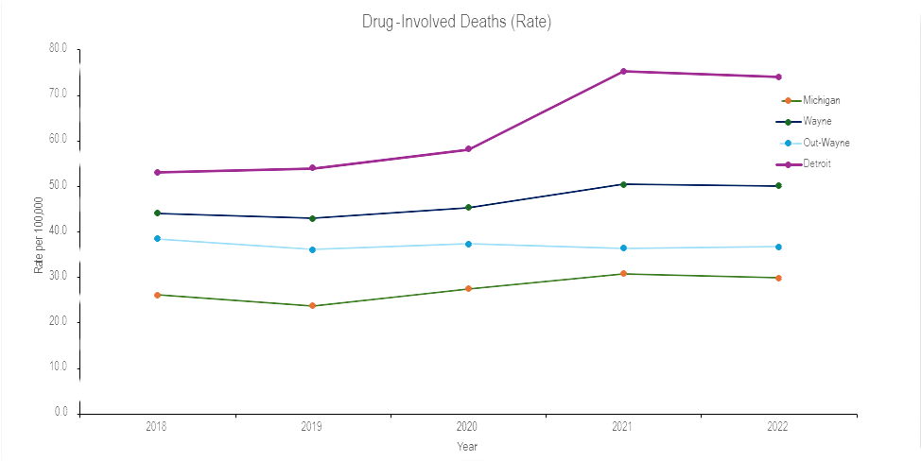
WAYNE COUNTY OVERDOSE DEATHS
2018 - 2022 (Rate per 100,0000)
Work underway to determine current trends
Source: Michigan Overdose Data to Action (MODA) Dashboard, Michigan Department of Health and Human Services (2024)
https://www.michigan.gov/opioids/category-data

Slide 5
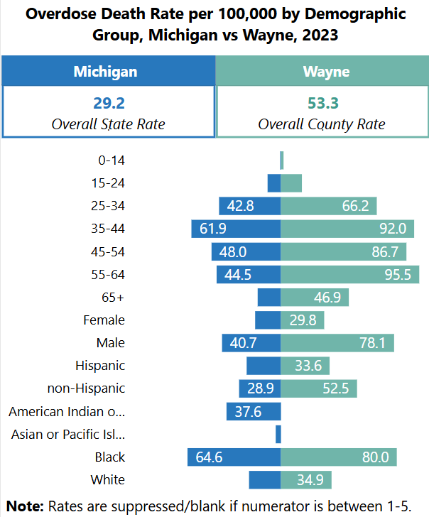
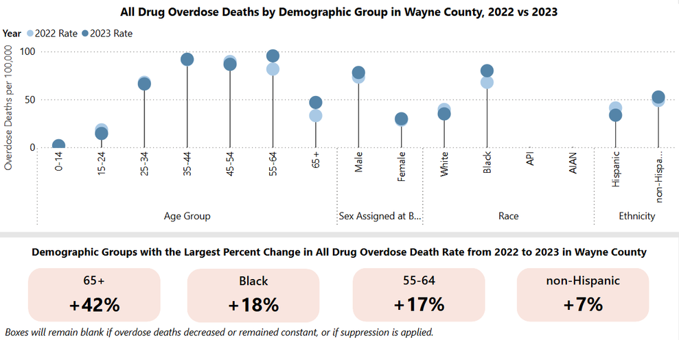
WAYNE COUNTY OVERDOSE IMPACT
Largest impact among Black, Males, Ages 55-64 and 35-44
Largest increase in 65 years and older and Black community
Source: Michigan Overdose Data to Action (MODA) Dashboard, Michigan Department of Health and Human Services (2024)
https://www.michigan.gov/opioids/category-data

Slide 6
FENTANYL
AND EMERGING DRUG TRENDS

Slide 7
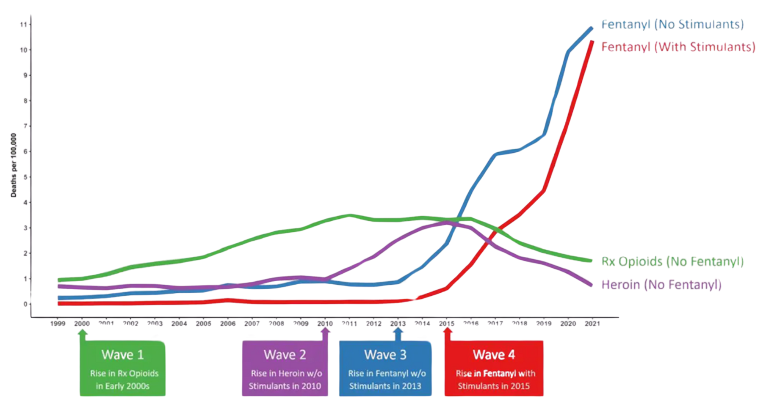
Fourth Wave of Overdose Epidemic
Marked by rise in Fentanyl in combination with stimulants

Slide 8
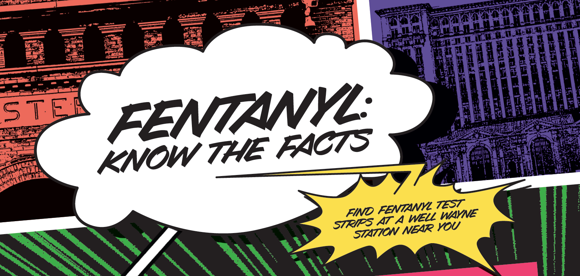

Slide 9
Fentanyl is...
A strong, fast-acting opioid
Up to 50x stronger than heroin and 100x stronger than morphine
Found in many different types of drugs…you can't see, taste, or smell fentanyl. Many don’t know that a drug contains fentanyl.
One of the most common drugs involved in overdose deaths in the United States
Involved in 4 out of 5 overdose deaths in Wayne County
Any drug that is not prescribed by a doctor may be contaminated with fentanyl.

Slide 10
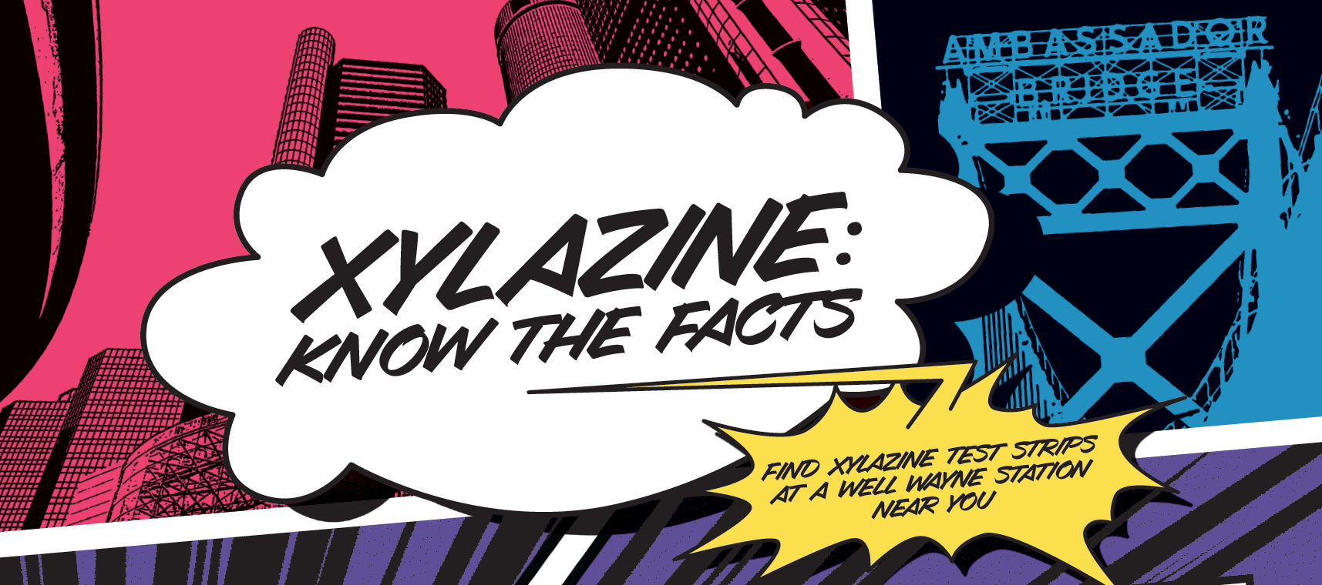

Slide 11
AN EVERCHANGING DRUG SUPPLY
Drugs identified in local overdose deaths
Xylazine (zye-luh-zeen)
“Tranq”
Increasing in the drug supply. Increases overdose risk.
Tranquilizer (sedative) used in veterinary medicine
Not an opioid, but almost always found with fentanyl (opioids)
Can slow down the brain and breathing, make the heartbeat slower, and lower blood pressure
Can cause severe wounds and sores that can worsen quickly
Often found in drugs or counterfeit pills that also contain fentanyl and other substances
Many people are not aware drugs they may be using contain xylazine

Slide 12
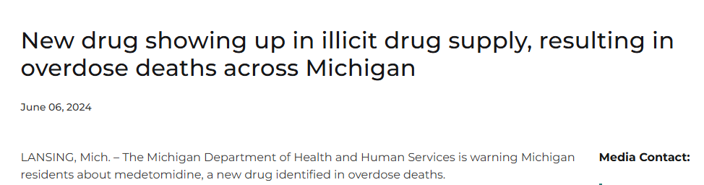
AN EVERCHANGING DRUG SUPPLY
Drugs identified in local overdose deaths
Medetomidine (med-eh-tome-ah-deen)
Found in about 14 postmortem samples since March 2024
Animal tranquilizer (similar to xylazine) 100-200x stronger than xylazine
Often found with xylazine, fentanyl and other substances

Slide 13
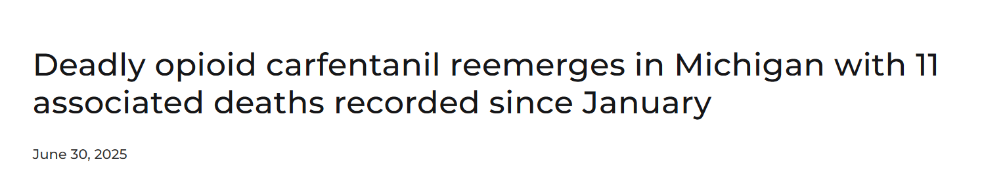
AN EVERCHANGING DRUG SUPPLY
Drugs identified in local overdose deaths
Carfentanil
Deadly, fast-acting opioid, 100x stronger than fentanyl
Developed for use as large-animal sedative
Found with many other drugs, including fentanyl
Notes:
Deadly opioid carfentanil reemerges in Michigan with 11 associated deaths recorded since January

Slide 14
PREVENTION TIPS
Be aware that any drug that isn’t prescribed by a doctor, may be contaminated with more dangerous drugs, like fentanyl
Learn how to recognize an overdose
Carry naloxone
The safest choice is to avoid illicit drugs
If you do use…
Never use alone
Carry naloxone
Use drug checking/testing strips

Slide 15
HARM REDUCTION
EVIDENCE-BASED PRACTICES
IN OVERDOSE PREVENTION

Slide 16
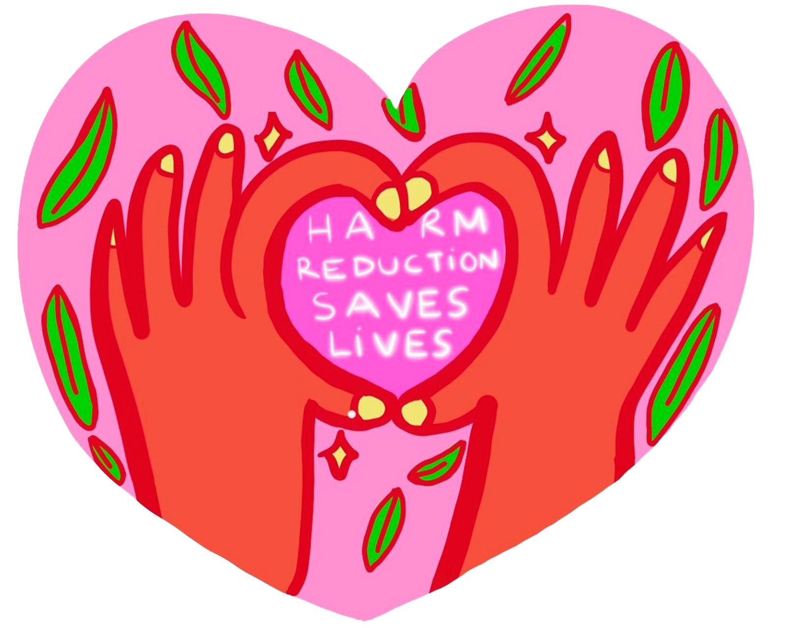
HARM REDUCTION SAVES LIVES
“Harm Reduction Saves Lives” by artist Malicia
Source: https://www.streetworksmn.org/oopr/

Slide 17




HARM REDUCTION SAVES LIVES
Reducing harm from substance use and protecting the health and wellbeing of individuals and communities
Naloxone (Narcan®) Access
Lifesaving overdose reversal medication
Community-wide access
Increasing access in most impacted communities
Drug Checking: Fentanyl/Xylazine Test Strips
Checking/Testing services
Empowering communities through free, low barrier access to drug checking supplies

Slide 18
WELL WAYNE STATIONS

Slide 19
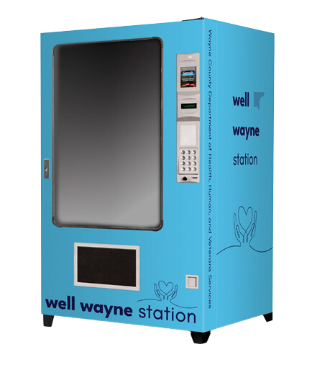
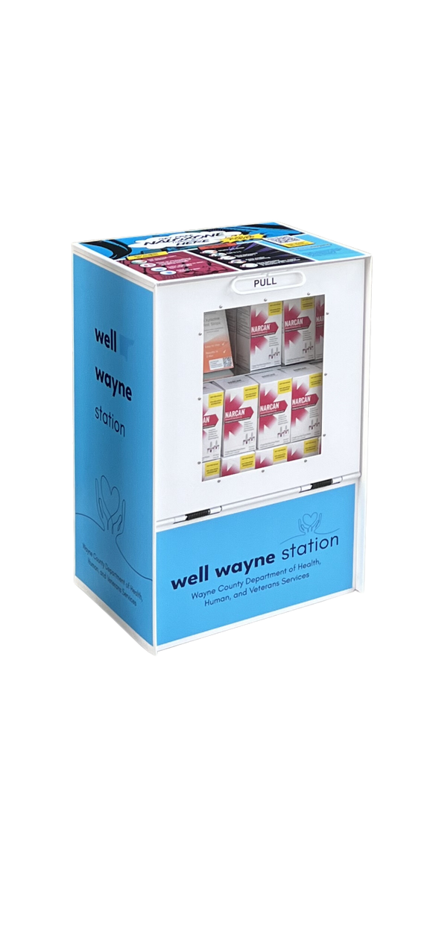
WELL WAYNE STATIONS
County-wide scaling of community naloxone access through public health vending machines and newsstand-style devices
Establishing local access points in all 43 municipalities
Prioritizing access in communities most impacted
Working with partners and across sectors to identify diverse host sites
Addressing and impacting stigma
LIFESAVING SUPPLIES
Naloxone (Narcan®)
Fentanyl Test Strips (FTS)
Xylazine Test Strips (XTS)
Wellness branding for future public health supplies

Slide 20
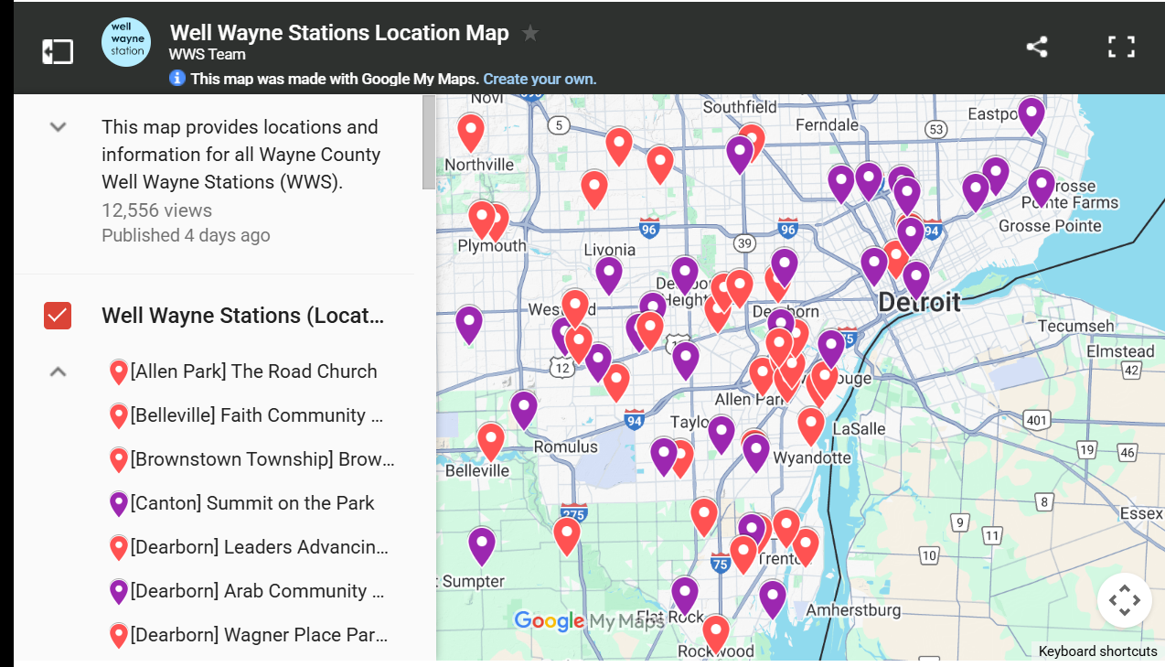
WELL WAYNE STATIONS
Current Sites and Community Access
76 stations
29 vending machines
47 newsstands
38 of 43 municipalities with active station(s)
Placement in 33 most impacted communities
Map and site information for Well Wayne Stations available at endoverdosewayne.org

Slide 21
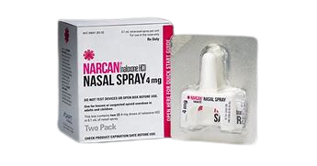
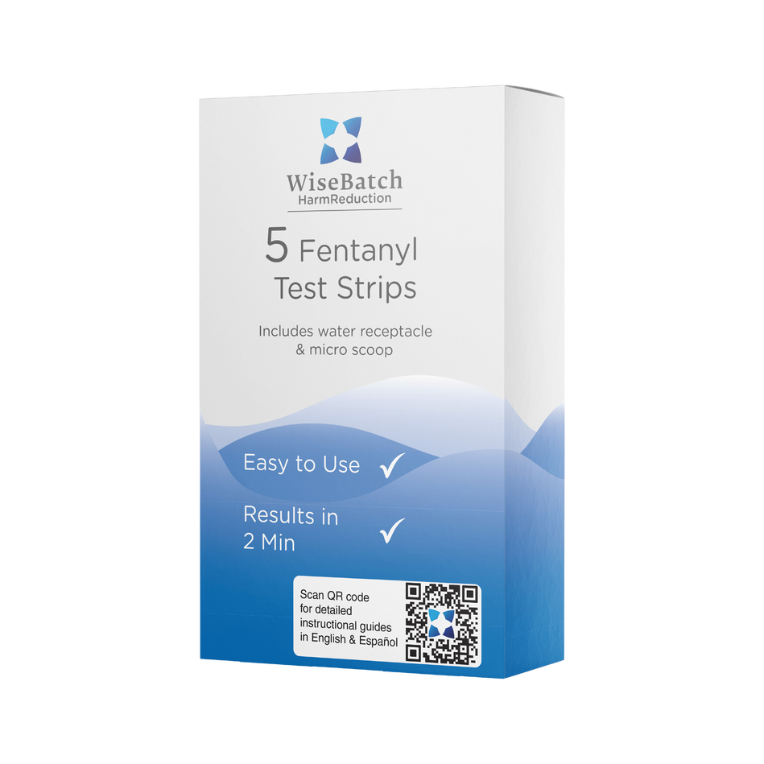
WELL WAYNE STATIONS SUPPLIES DEPLOYMENT
Supplies deployed September 1, 2024 – October 13, 2025
Naloxone (Narcan): 20307 naloxone kits
40614 doses
Fentanyl Test Strips: 7097 FTS kits
35485 fentanyl test strips
Xylazine Test Strips: 4551 XTS kits
22755 xylazine test strips
SEPTEMBER 2025 SUPPLIES DEPLOYMENT
1074 naloxone kits
212 fentanyl test strip kits
248 xylazine test strip kits

Slide 22

SUPPORT
NOT STIGMA
Anyone can experience stigma, and it can make getting help harder. People who experience substance use and mental health conditions as well as people who use drugs need support and access to care.
Source: https://publichealth.jhu.edu/2022/what-is-harm-reduction

Slide 23
IMPACTING STIGMA
More than 40% of individuals know someone who has experienced an overdose
1 in 7 individuals will experience a substance use disorder (SUD) in their lifetime
Source(s): https://www.ncbi.nlm.nih.gov/books/NBK424857/
SAMHSA Releases Annual National Survey on Drug Use and Health | SAMHSA

Slide 24
IMPACTING STIGMA
“Stigma” may come in many forms. It includes negative attitudes, beliefs, and stereotypes that people may hold toward those who experience substance use disorders and/or mental health conditions, as well as people who use drugs (PWUD).
Stigma can impact prevention and treatment
Interactions matter: Perceptions, treatment, present and past experiences
Trust-building or trust-breaking
Stigma can prevent or delay people from seeking care or other supports
Language matters
Language can support and empower or stigmatize and disempower
Person-first

Slide 25
IMPACTING STIGMA
Increasing engagement, education, and awareness
Nearly 49 million (15%) people aged 12 or older in the U.S. reported a presence of an SUD in the past year (2022 National Survey on Drug Use and Health; SAMHSA)
An estimated 1 in 5 adults live with a mental illness; over 53 million adults in the U.S. (2022; NIH)
Rates of stigma are extremely high both in the general public and within professions whose members interact with people with SUD, including health care professions
Understanding substance misuse, substance use disorders (SUD), mental health conditions, and co-occurring disorders
Although substance use disorders and mental health conditions are chronic, treatable medical conditions, studies show that people who have them often face stigma and discrimination, in part because others do not understand these disorders or how they can be effectively treated.

Slide 26
IMPACTING STIGMA
Learning from the lived and living experiences of others
Elevating people with lived/living experience and providing active opportunities for voices (and their stories) to be heard
Valuing cultural and experiential knowledge and expertise, as essential in work concerning health, behavioral health, emergency/crisis response, the criminal-legal system, and the community
Promoting health equity and justice; treating all individuals with respect and dignity

Slide 27
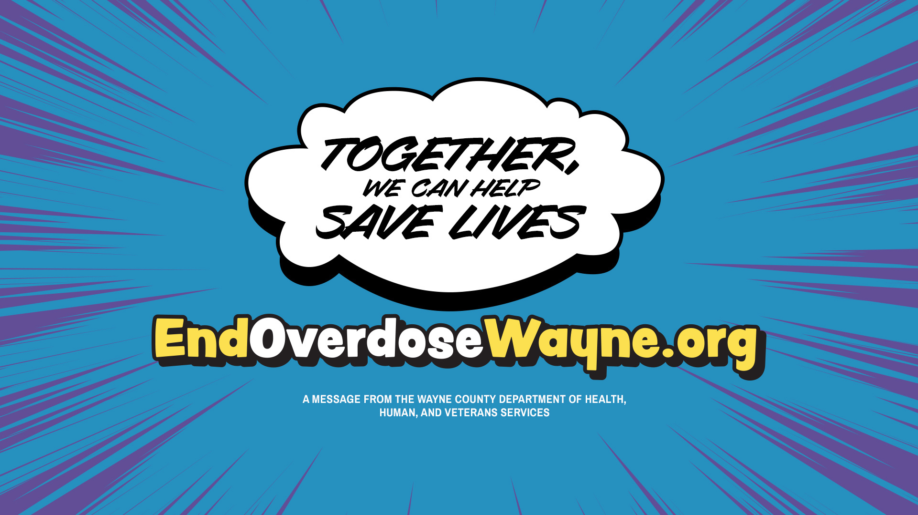
hhvs_cbh@waynecountymi.gov

