Slide 1
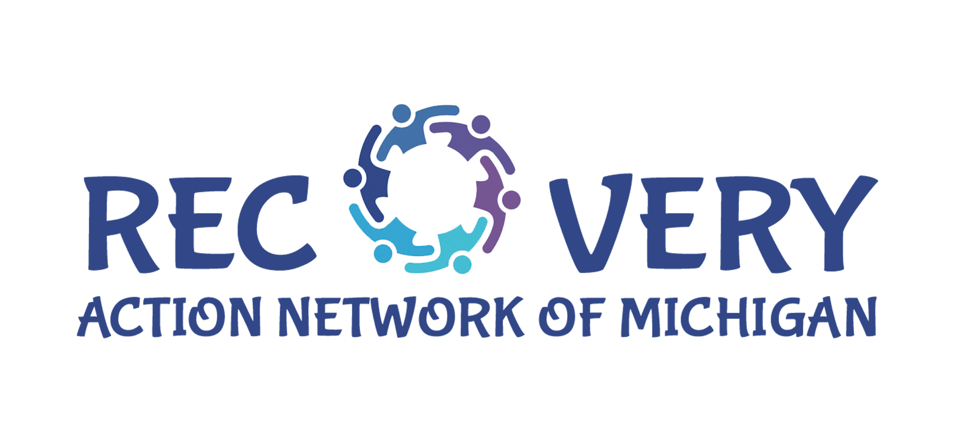

Narcan (Naloxone) Training:
Life-Saving Overdose Reversal
Allison Herrst, LLMSW, CPRC, CPRM

Slide 2


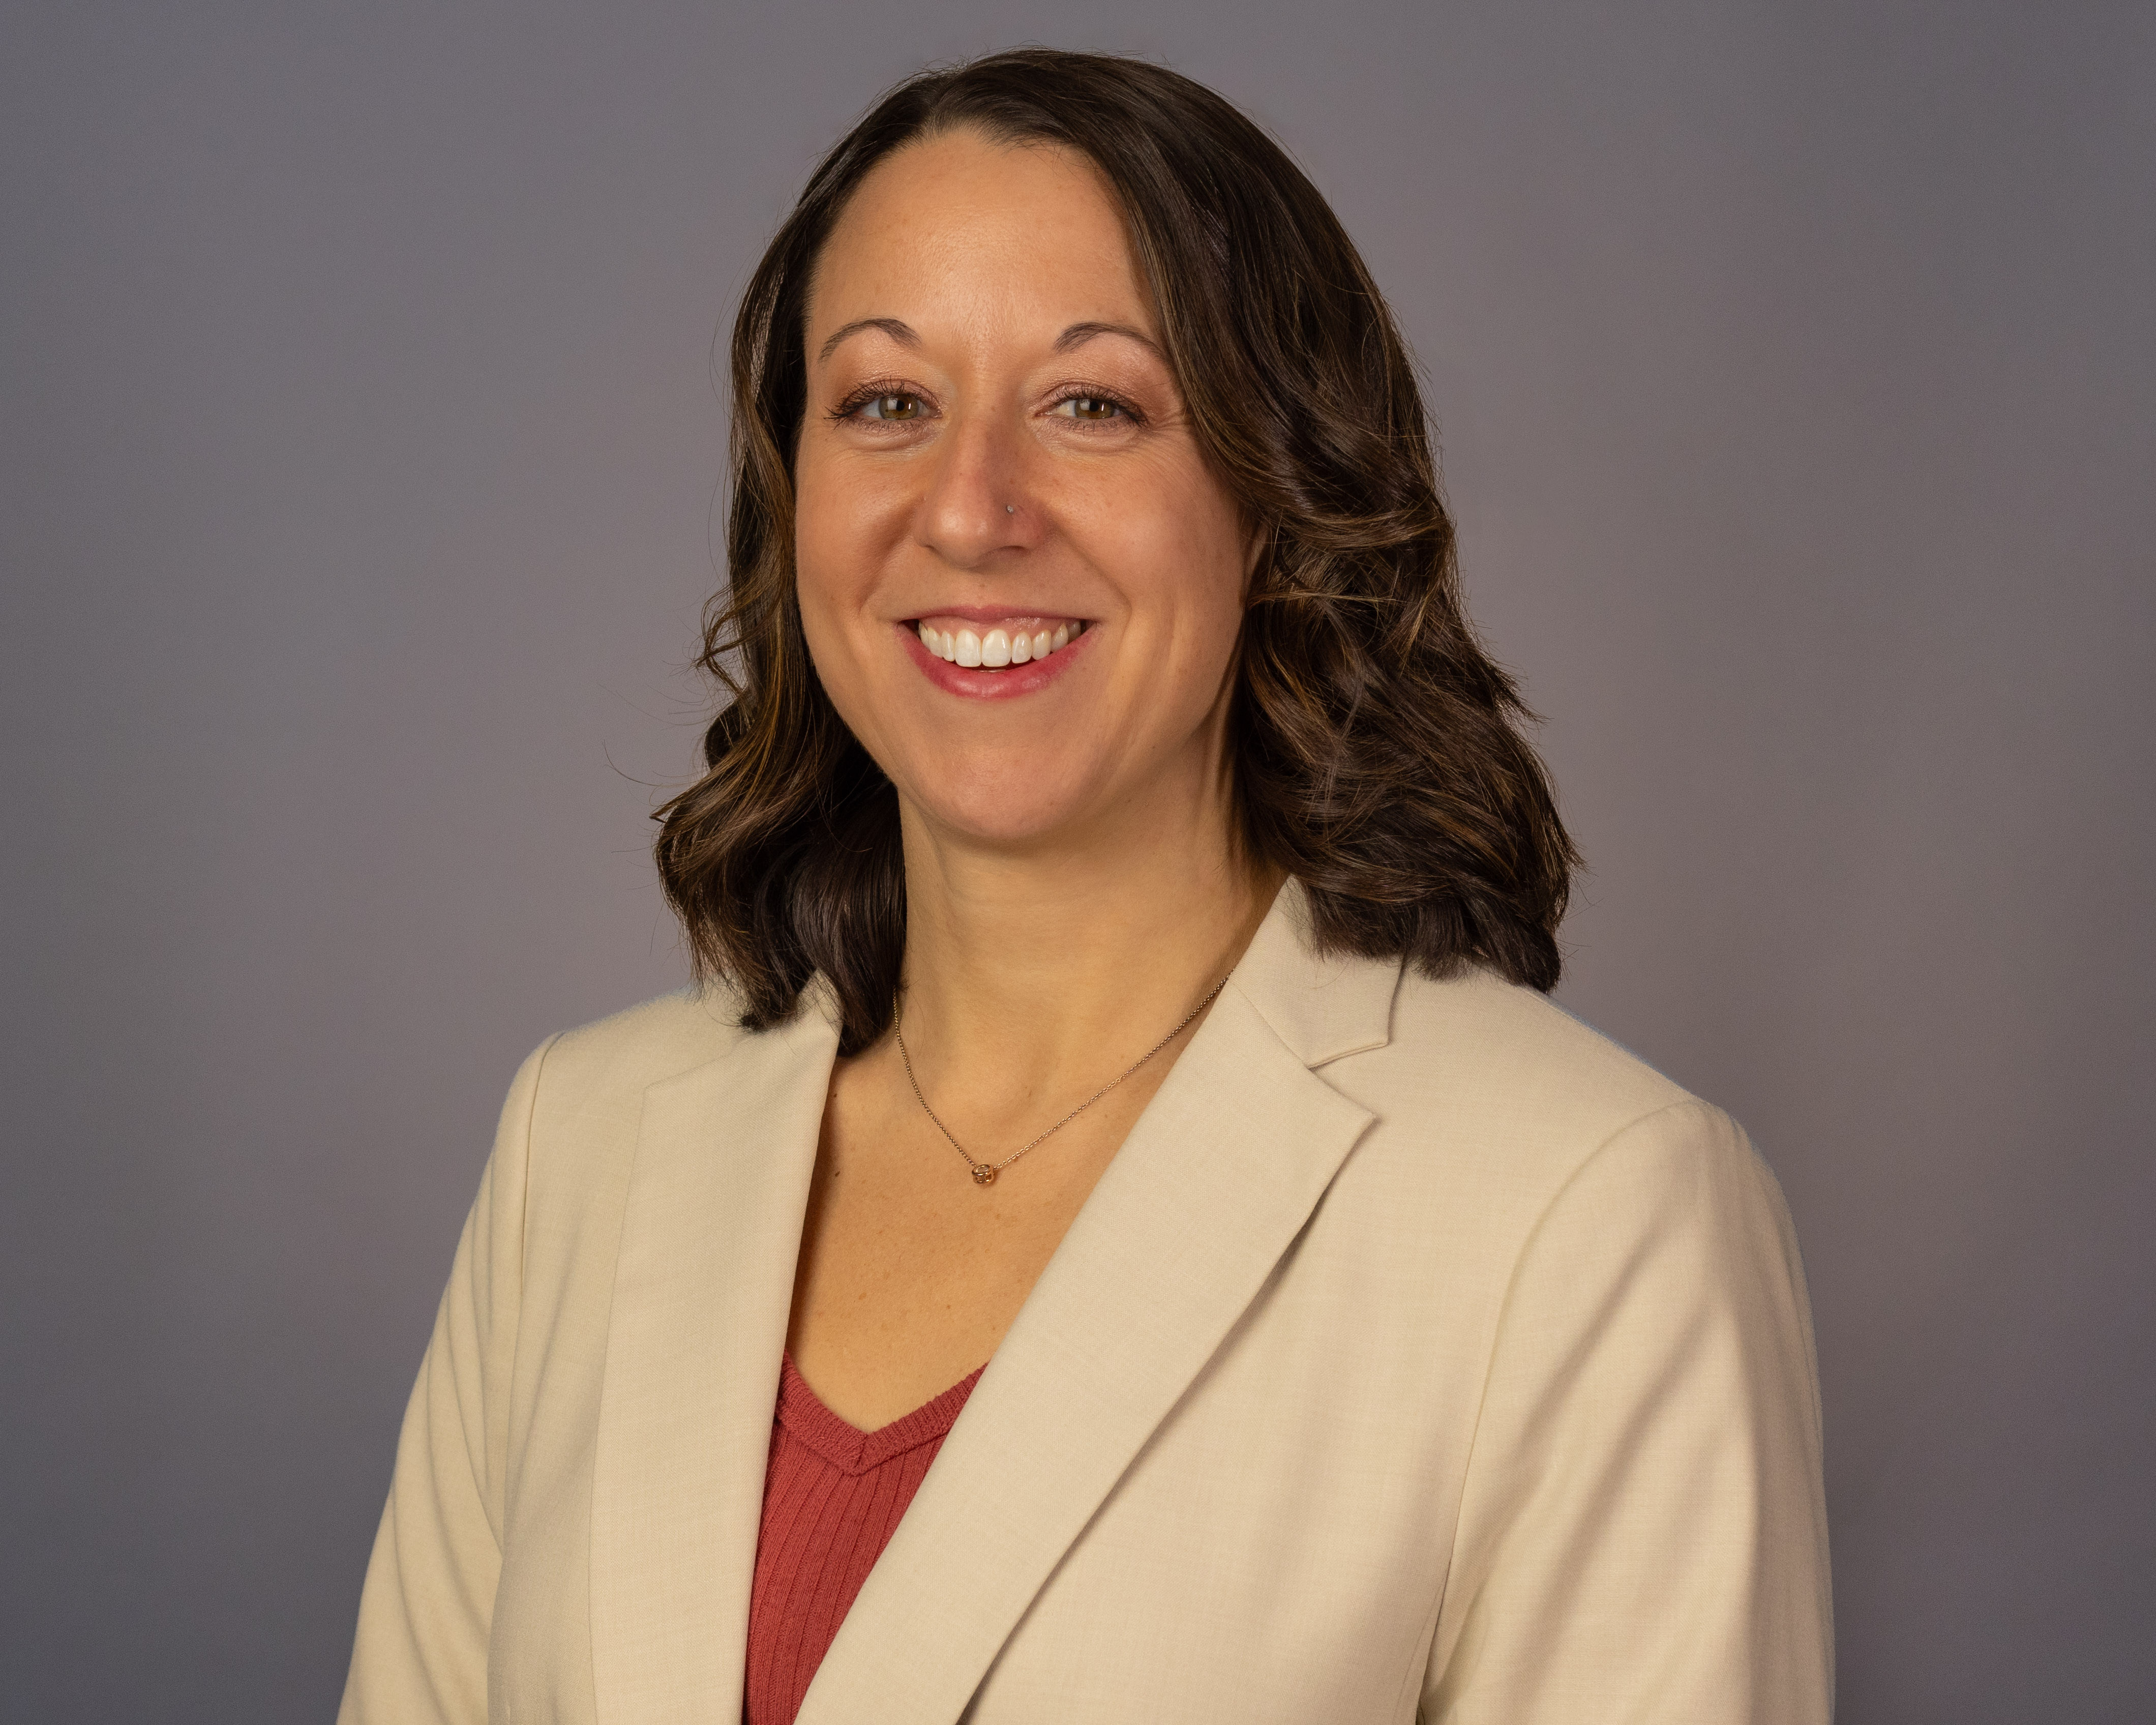
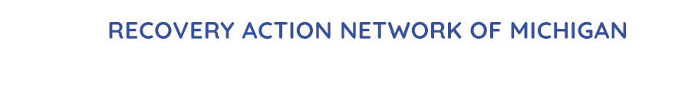
Recovery Action Network of Michigan
Allison Herrst, LLMSW, CPRC, CPRM
Executive Director, RANMI 248-938-2134 allison.herrst@ranmi.org www.ran-mi.org
2

Slide 3
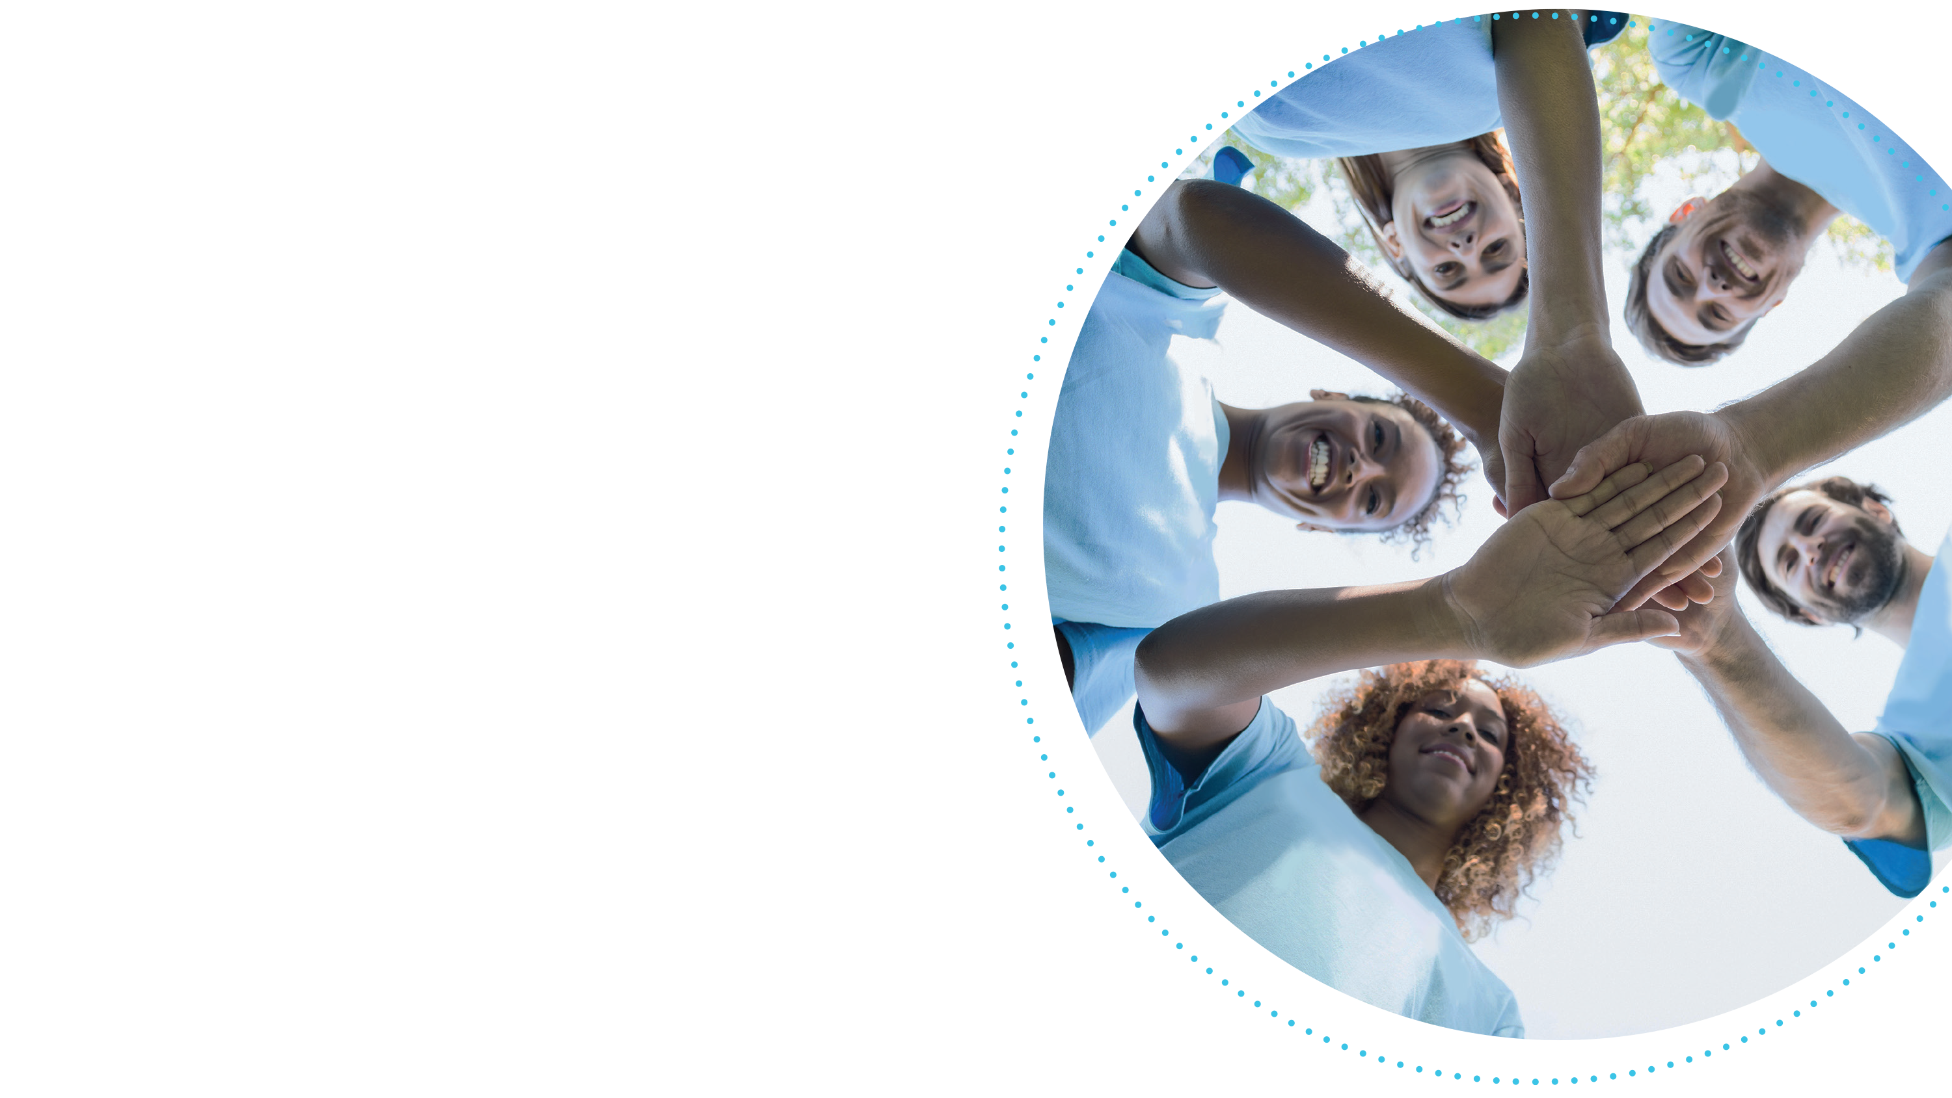
Objectives
Introduction to Naloxone (Narcan)
Myths About Overdose
Recognizing an Overdose
How Naloxone Works
Steps to Administer Narcan
Post-Naloxone care
Q & A
3

Slide 4
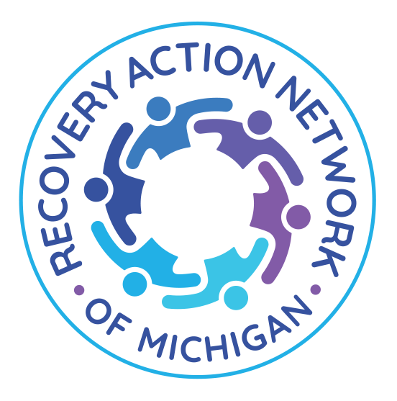
What is Naloxone (Narcan)?
Definition: Naloxone (commonly known as Narcan) is a medication designed to rapidly reverse opioid overdose.
Key Points
Works by binding to opioid receptors, reversing or blocking effects of opioids.
Can restore normal breathing within 2-3 minutes.
Available in different forms (nasal spray and injectable).
4

Slide 5
Why is Naloxone Important?
Opioid Overdose Crisis
Over 100,000 deaths annually in the U.S. (2022)
Opioids are the leading cause of overdose deaths
Prescription pain killers, heroin, fentanyl
Fentanyl is 50-100 times more potent than morphine
OD often occurs in people who mix opioids with other substances
The crisis impacts people across all demographics but disproportionately affects rural areas, people of color, and low-income communities
5

Slide 6
Why is Naloxone Important?
Opioid Epidemic - Contributing Factors
Over-prescribing of pain killers in the 1990s-2000s led to widespread addiction
Increased availability of synthetic opioids (i.e. fentanyl) in illicit drug markets
Lack of access to treatment for substance use disorders
Stigma around drug use and seeking help
6

Slide 7
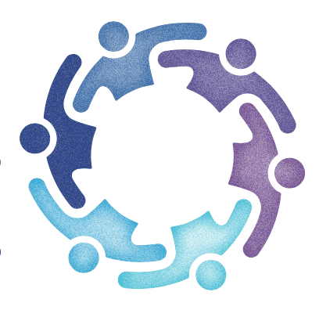
Myths About Overdose
Myth
ODs only happen to people who use drugs regularly
Fact
Can happen to anyone, especially 1st time or occasional users
Myth
You can tell someone is overdosing just by looking at them
Fact
Signs may not always be obvious, especially in early stages
Myth
Narcan encourages drug use
Fact
Narcan saves lives and offers a second chance for recovery
7

Slide 8
Myths About Overdose
Myth
You can “sleep off” an overdose
Fact
OD is a medical emergency that can be fatal if treatment is delayed
Myth
Overdoses only happen with illegal drugs
Fact
Prescription opioids, benzodiazepines, and alcohol are commonly involved
Myth
I can’t help someone who overdoses because I’m not a professional
Fact
Anyone can administer Narcan and save a life, even without medical training
8

Slide 9

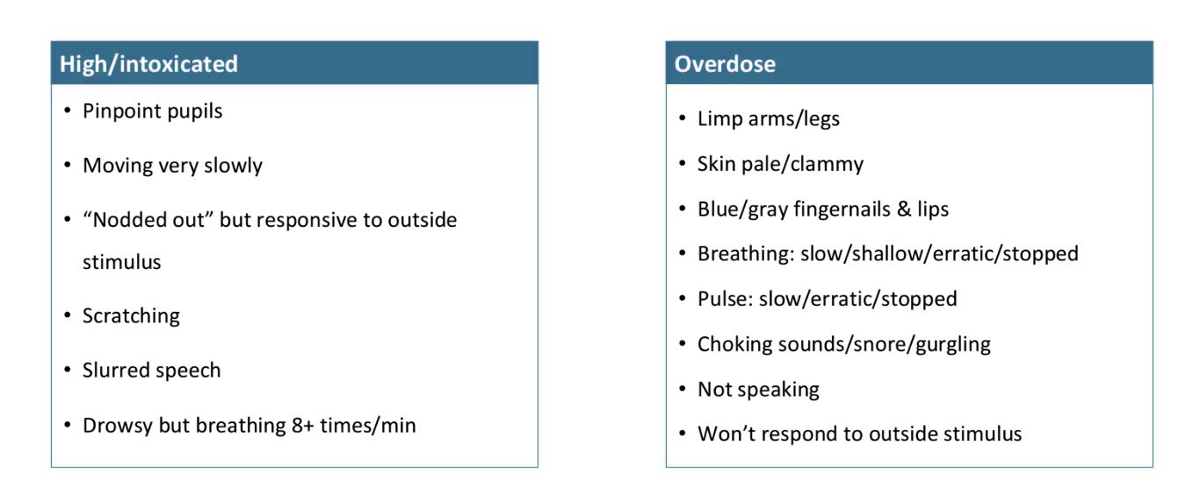
Recognizing an Opioid Overdose
9

Slide 10
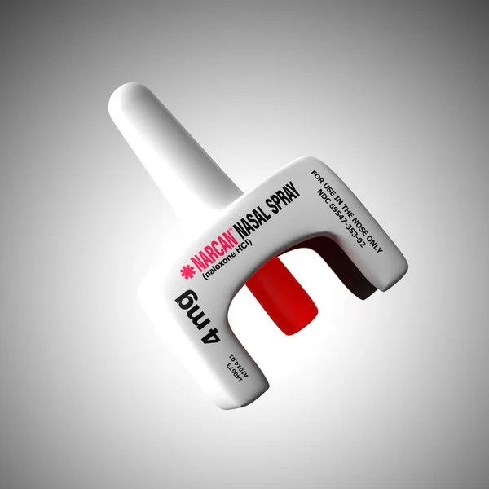
How Narcan Works
Mechanism of Action
Reverses the effects of opioids by blocking opioid receptors in the brain
Restores normal breathing and consciousness within minutes
Effective only for opioids, not other types of overdoses
10

Slide 11

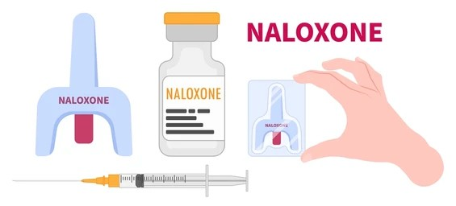
Forms of Naloxone
Nasal Spray
Pre-packaged
Easy to use
One spray in each nostril
Injectable
Requires a needle
Inject into muscle or vein
More common with medical professionals
11

Slide 12
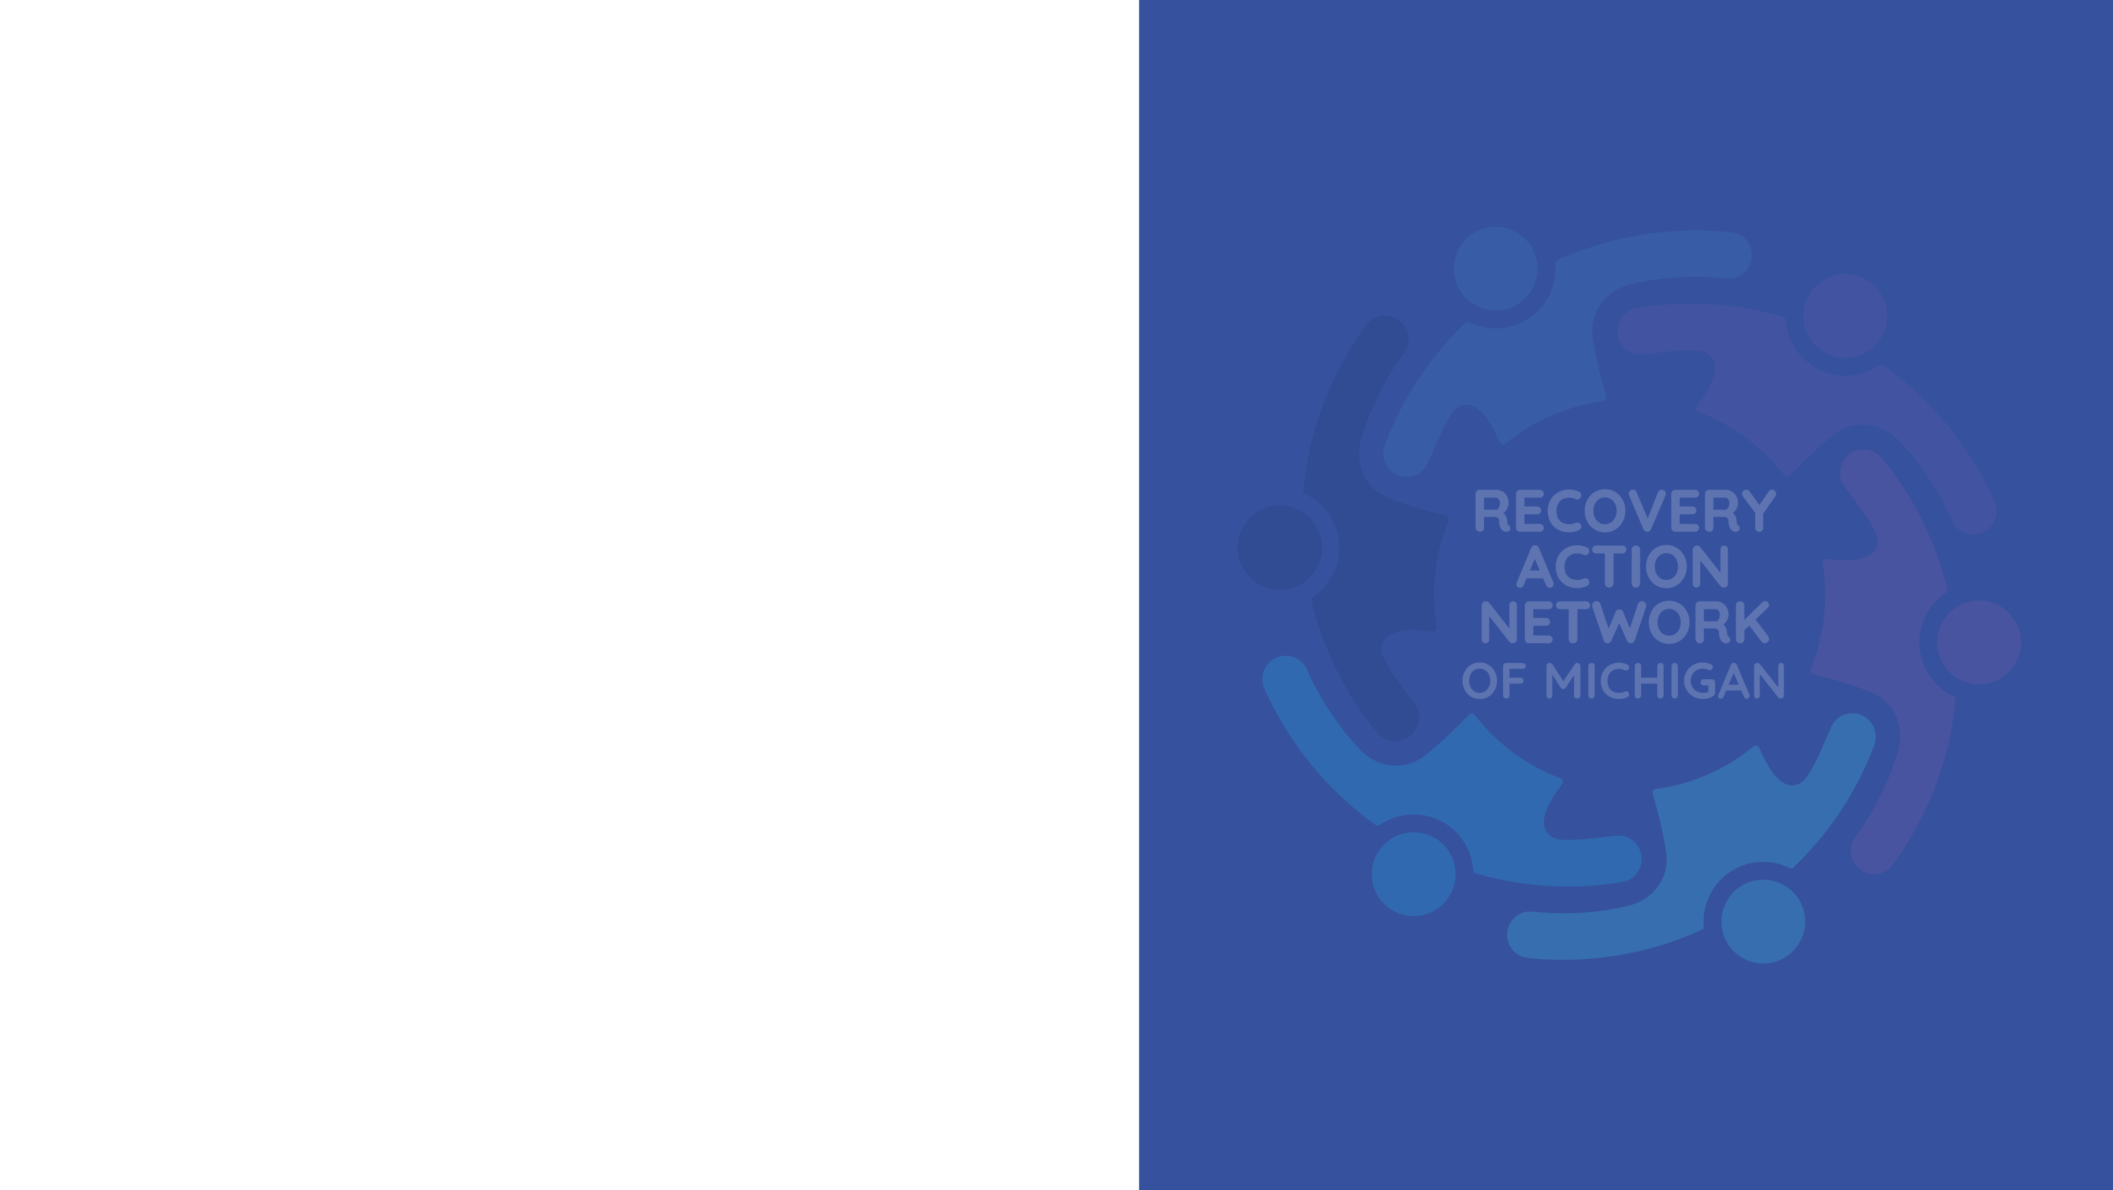
When to Use Narcan
Use Naloxone When
Person is unresponsive and not breathing or breathing slowly
Suspected opioid overdose (even if unsure)
Someone has a history of opioid use or prescription drug use
12

Slide 13
Steps to Administering Narcan
1. Check for Responsiveness
2. Call 911
3. Administer Narcan Nasal Spray
4. Wait and Monitor
5. Perform Rescue Breathing/CPR

Slide 14

After Narcan Administration
What to Expect
Person may regain consciousness in 2-3 minutes
If not – administer 2nd dose
They may experience withdrawal symptoms
Agitation, sweating, nausea
Continue monitoring until help arrives
Always ensure follow-up care is provided
14

Slide 15

Important Safety Notes
Naloxone has NO harmful side effects if given to someone not experiencing an opioid overdose
Multiple doses may be necessary
Naloxone works temporarily
Medical assistance is crucial
15

Slide 16
Good Samaritan Law
Michigan’s Good Samaritan Overdose Immunity Law (Public Act 307 of 2016).
Provides limited legal protections for individuals who seek help during a drug overdose.
The person seeking help and the person overdosing are protected from being charged or prosecuted for possessing a controlled substance (in amounts for personal use).
The law is designed to encourage people to call for emergency assistance without fear of legal consequences in situations where prompt medical intervention can save lives.
Immunity does not apply to other crimes (i.e. drug trafficking or manufacturing).
16

Slide 17
Where to Get Naloxone/Narcan
Pharmacies (without a prescription)
Local health departments
MDHHS
Community organizations
Recovery outreach programs
Narcan training events
Recovery Action Network
Face Addiction Now (FAN)
17

Slide 18
Key Takeaways
Narcan Saves Lives: Quick and easy to administer
Recognize the Signs: Always be prepared to act
Call 911: Medical support is essential
Multiple Doses May Be Necessary: Monitor 2-3 minutes
Spread Awareness: Encourage others to learn and carry Narcan

Slide 19
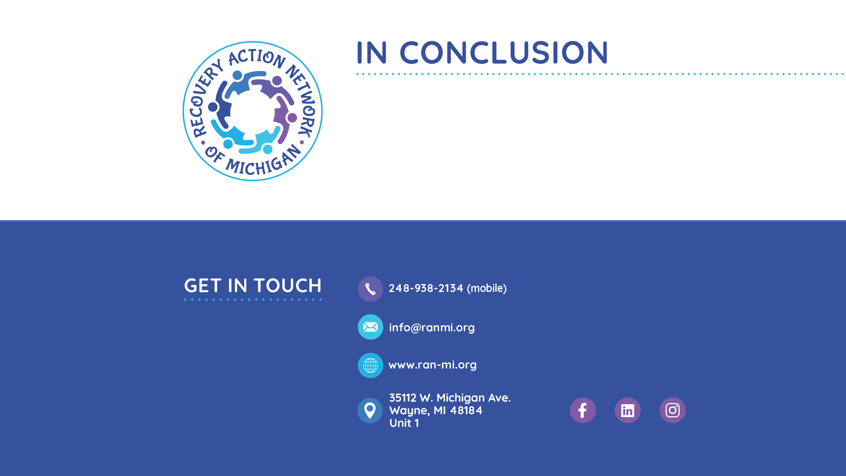

Slide 20
THANK YOU
Our mission is to empower individuals and families affected by addiction by providing a safe and supportive community where they can find hope, inspiration, resources and achieve long-term recovery.

